Slide 1
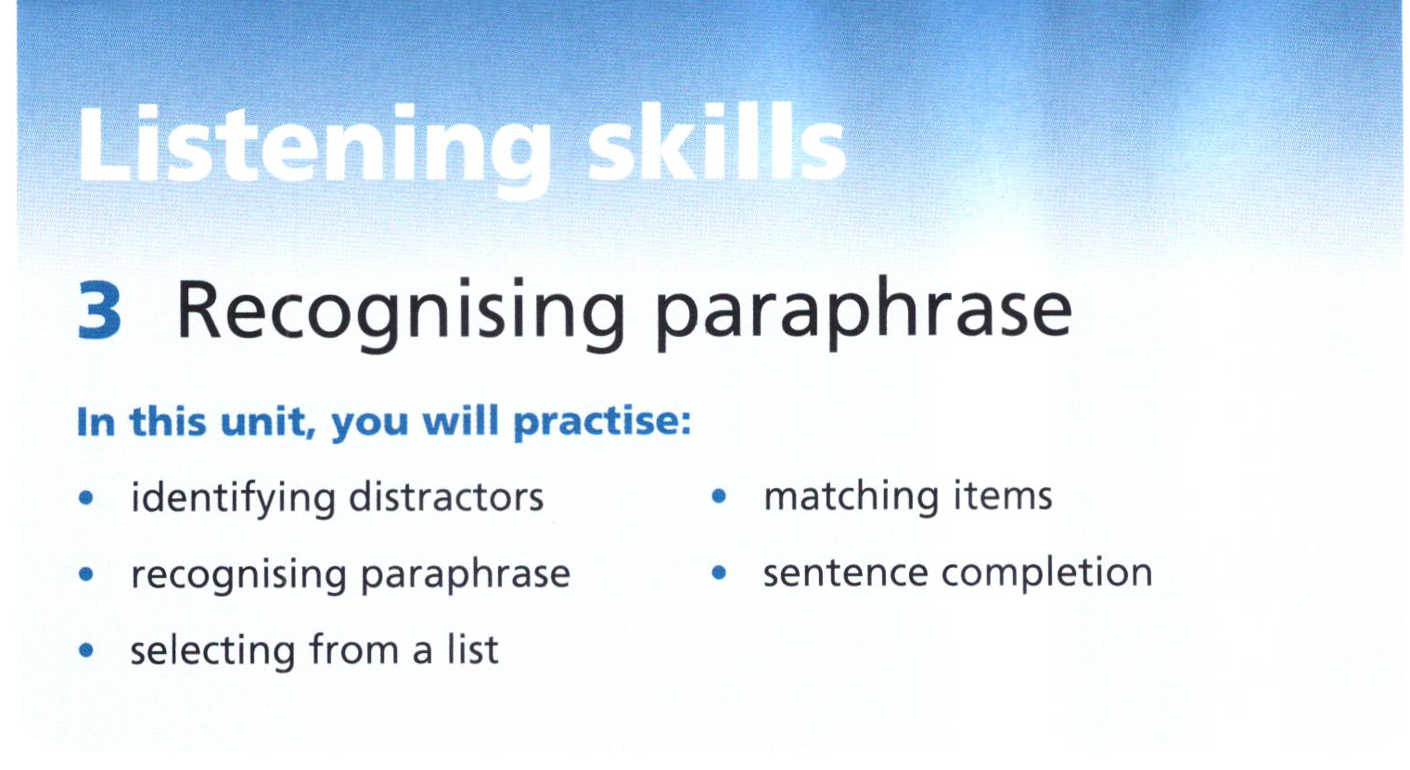

Slide 2
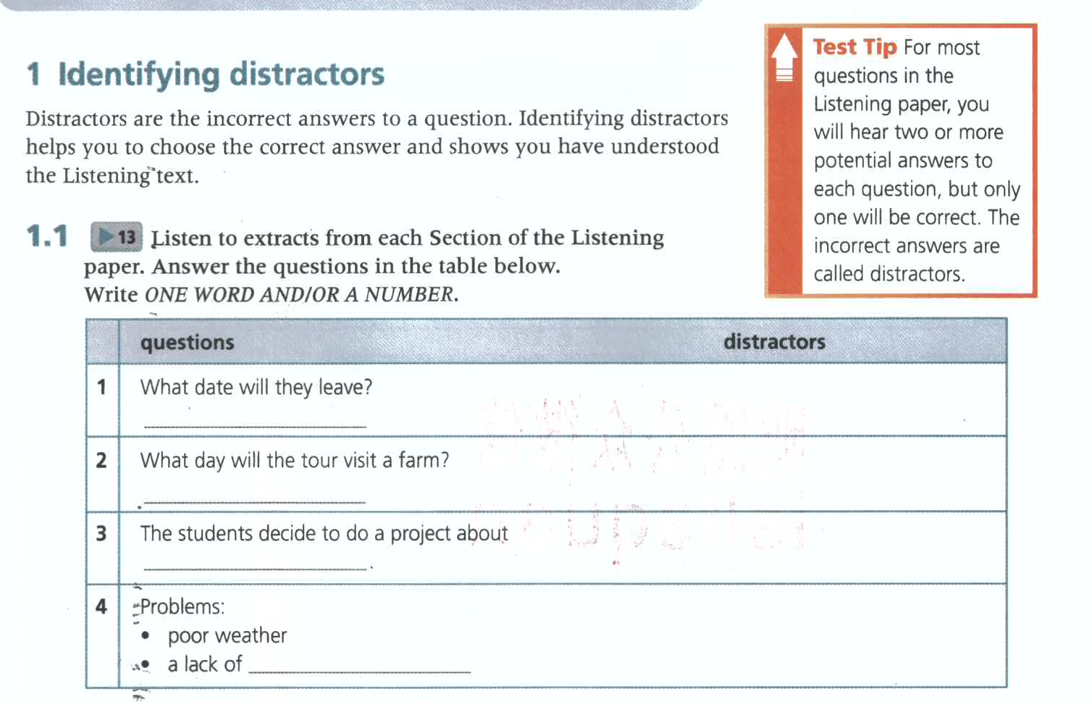
13
19th, 20th, 21st
18th July
Wednesday
Tuesday, Thursday, Friday
recycling
environment, pollution
equipment, volunteers
funds

Slide 3
13-1
Listen again for accuracy.
Scotland | wedding
wedding
 | 18th
special dinner
21st
fly in
19th

Slide 4
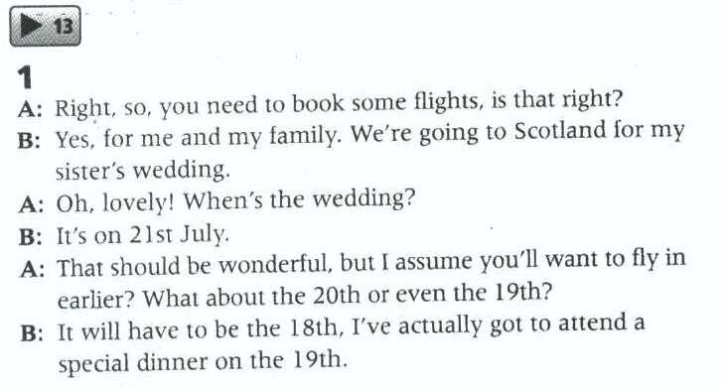
13-1

Slide 5
Listen again for accuracy.
13-2
Time | Do what | Details
Tuesday morning
Wednesday
Thursday
Friday
local farm produce
on sale
go to a market
visit a local farmer
where they come from
relax
leave

Slide 6
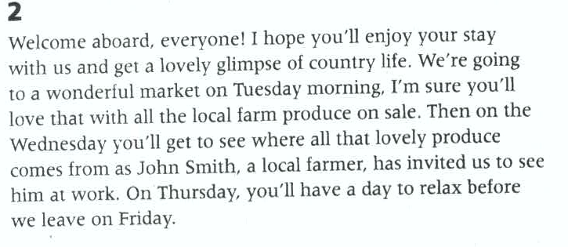
13-2

Slide 7
13-3
Listen again and take your own notes in details.
Project: due in 3 weeks
Environment: broad, narrow down
Recycling: good, information,
nice, different
Pollution: other groups

Slide 8
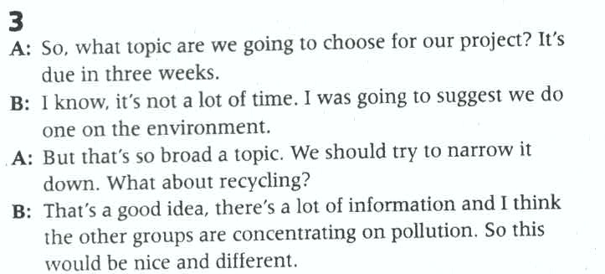
13-3

Slide 9
13-4
What are the problems and solutions?
Problems | solutions
Horrendous weather | equipment
Run out of funds | postpone

Slide 10
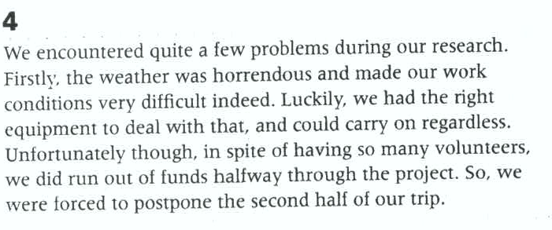
13-4

Slide 11
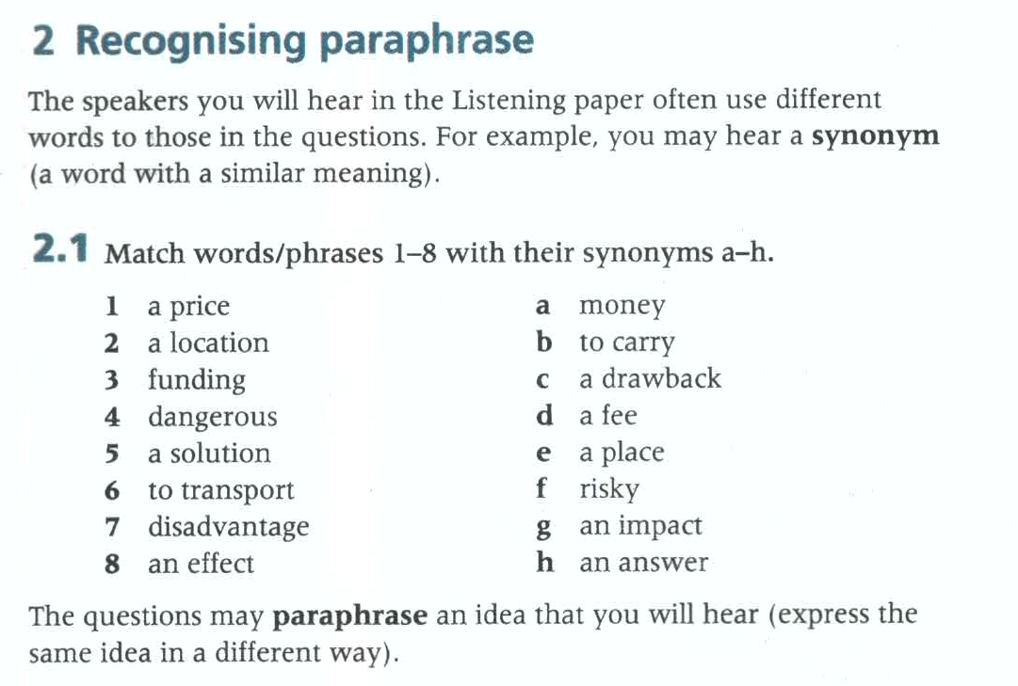

Slide 12
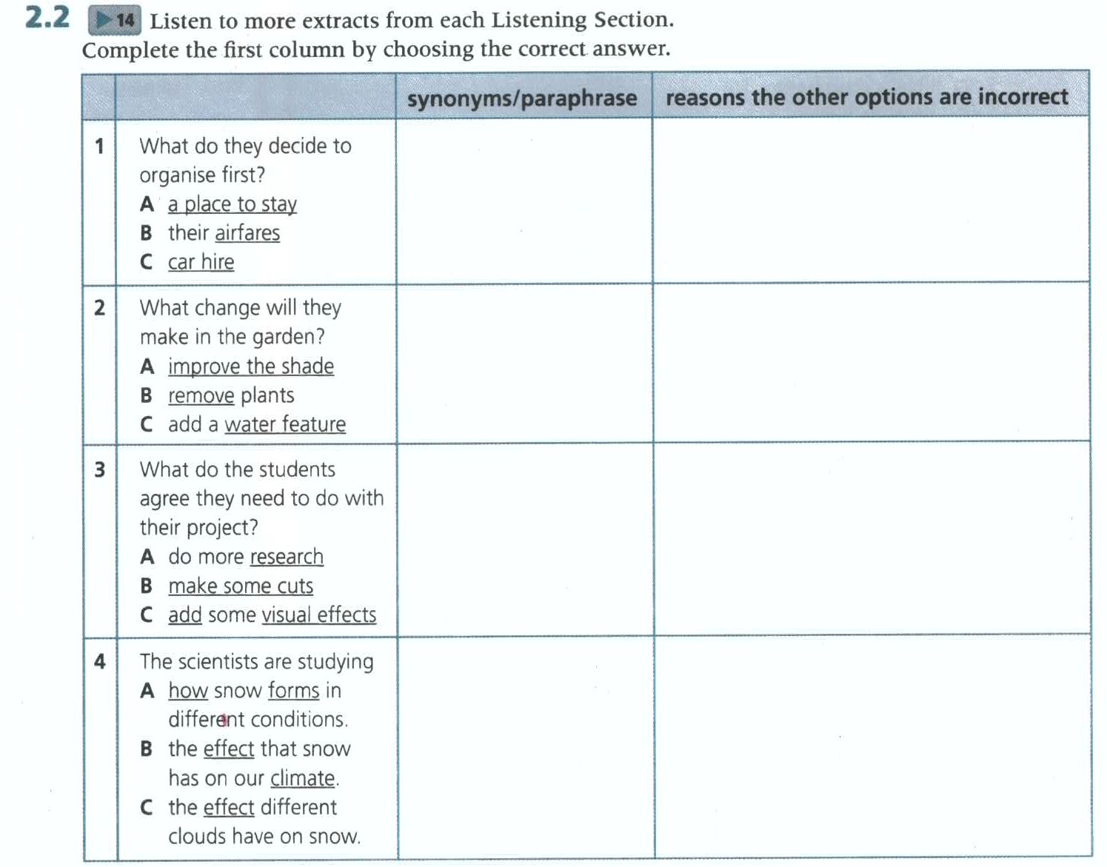
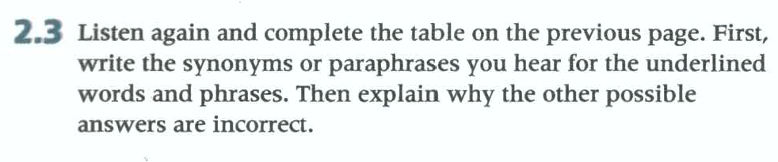
14
Accommodation/hotel
They will do it in the morning
flights
transport
They’ll borrow a car
plant trees
take out
They don’t want to do this.
pond
They already have one.
(find) information
They have plenty.
Reduce any of it
They don’t want to do this at all.
Include graphics
Process; is created
They already know this.
Influences weather patterns
They want to do the opposite—see if snow affects clouds.
impact

Slide 13
Things needed to do before the trip.
14-1
accommodation
flights
car
sort out ∵ booked up,
book from a travel agent
borrow

Slide 14
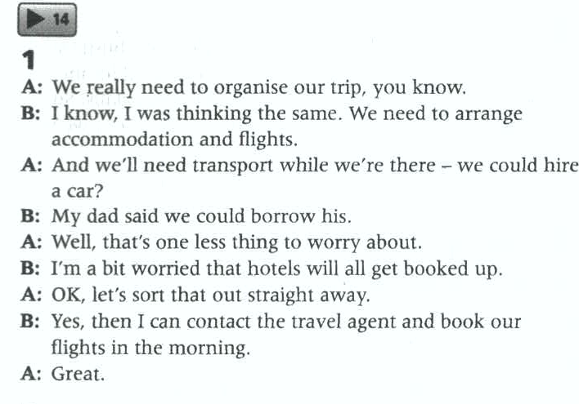
14-1

Slide 15
Listen for signposts or key words to follow the talk.
14-2
signposts/keywords | functions | information
 |  | at the back of complex
changes on garden
topic
well-established trees, not want to take out
as you know
fact
but
problem
struggle in harsh sun
to solve this
solution
plant trees,
also
addition
make it pleasant place

Slide 16
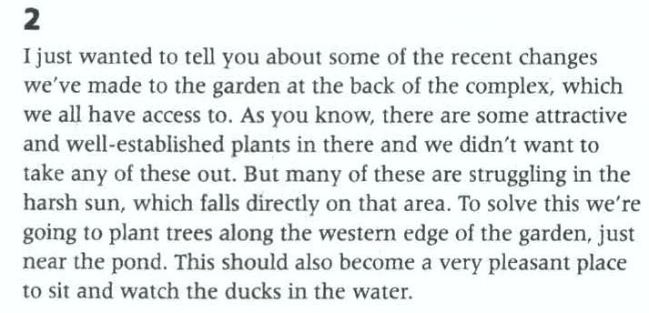
14-2

Slide 17
Listen for clues to follow.
14-4
Study ice cores:
Past climate
How climate change
My area: snow
A lot about process snow created
Little about snow interacts atmosphere , influences weather patterns
One thing to do
Link what we know about meteorology and clouds and determine the impact of snow

Slide 18
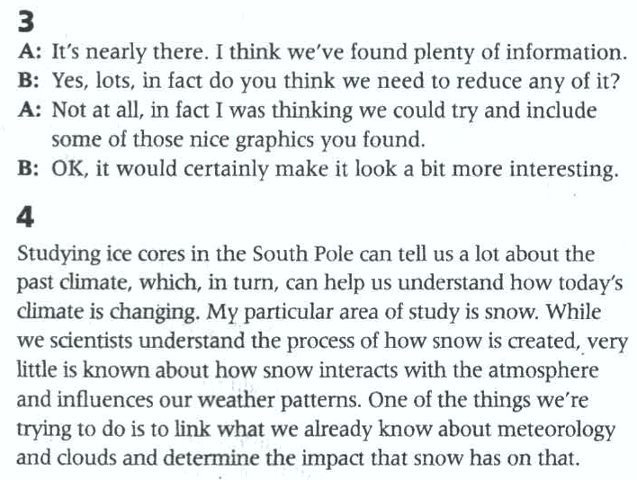
14-3
14-4

Slide 19
15
Listen for the following information
topic | OP56 mobile phone | Other information
features | 1
 | 2
 | 3
 | 4
disadvantages | 1
 | 2
slimmer, lighter
older model compared
screen increased↑
neatly fit pocket
camera improved
better quality pics
easy to use
battery impacted
(×)not run for long
overpriced
beyond budget

Slide 20
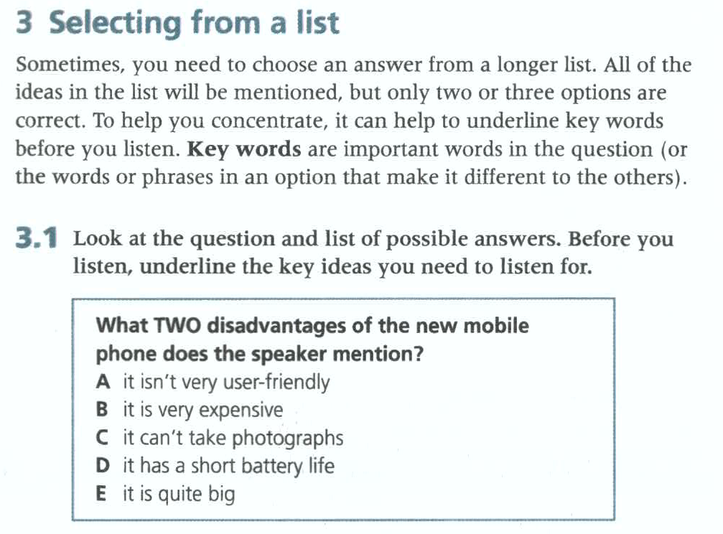

Slide 21
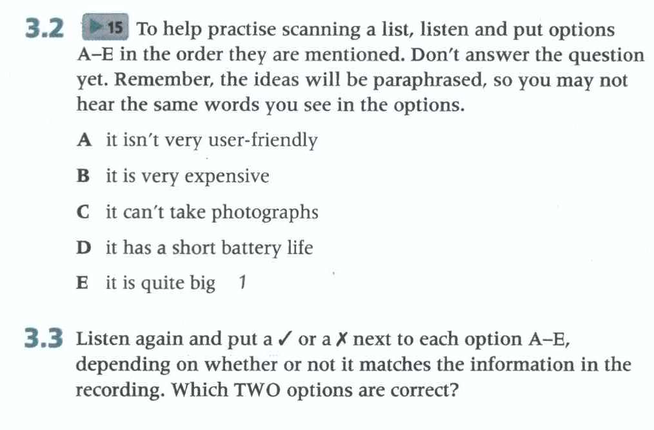
4
×(it is easy to use)
5
√
2
×(it can take very good photos)
3
√
×(it has a big screen but this is not a disadvantage– it still fits in your pocket.)

Slide 22
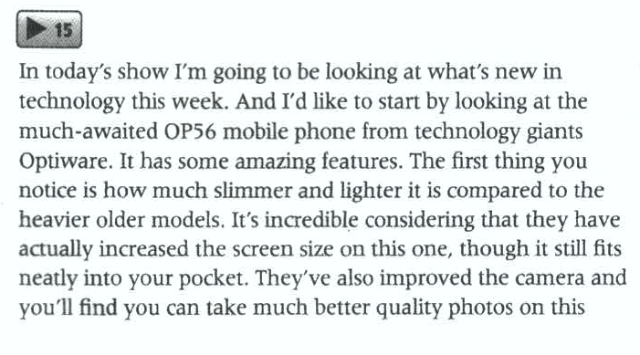
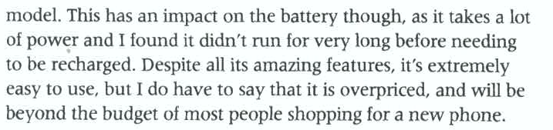
15

Slide 23
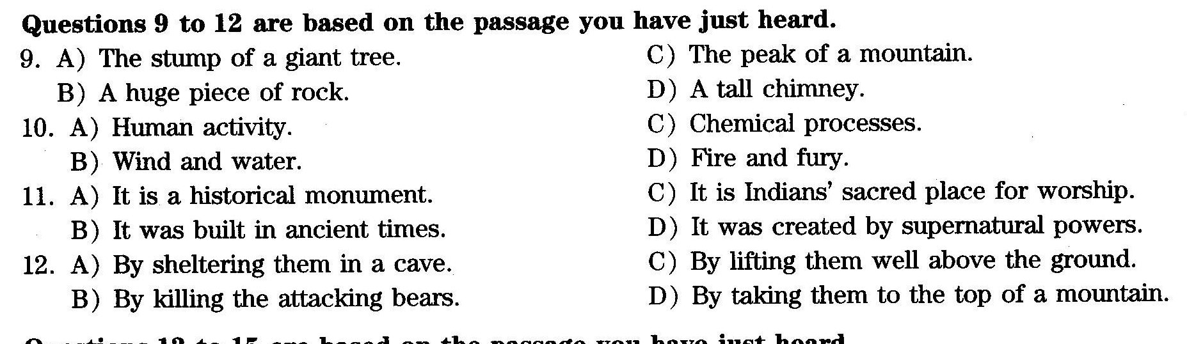
16.12p-1
2016年12月第一套

Slide 24
